Slide 1

Bounded Model Checker for C/C++

Slide 2
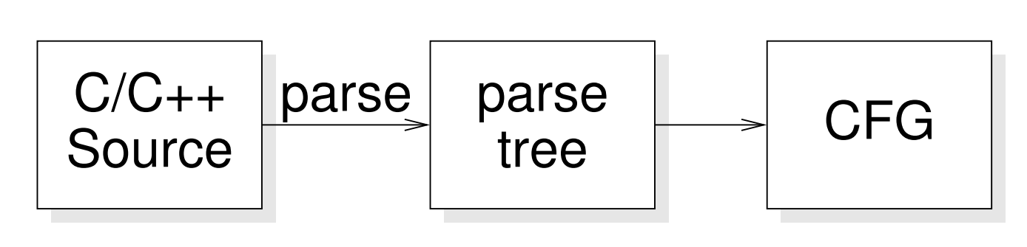
Model Checker
Control Flow Graph

Slide 3
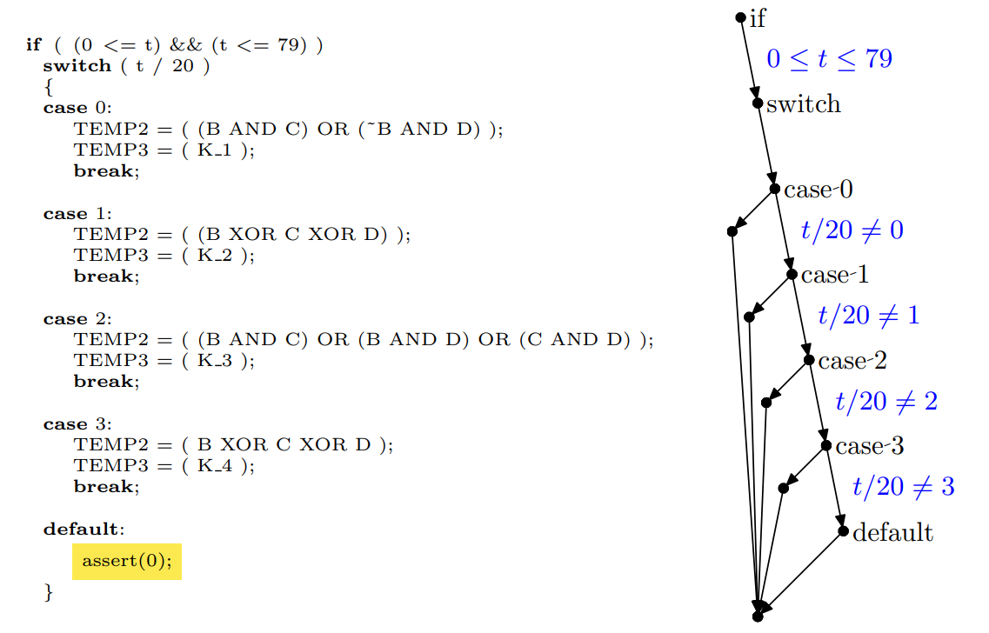
Model Checker ~ CFG
Notes:
Insert assert to prove unreachable code

Slide 4
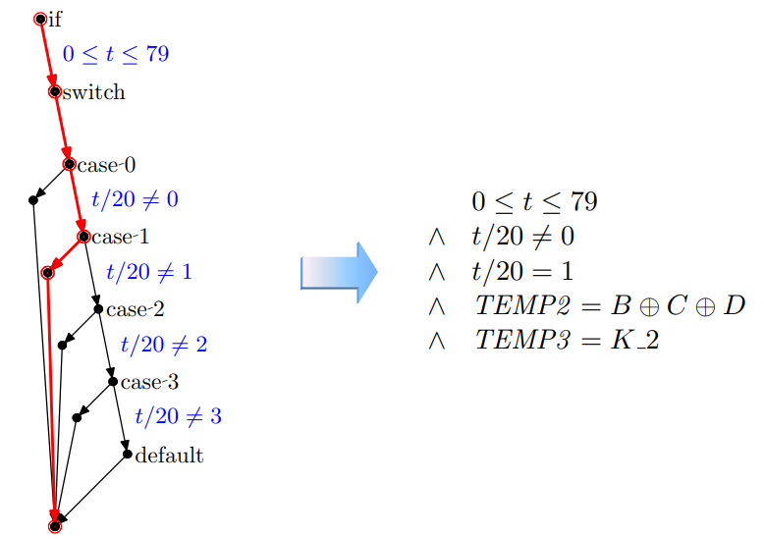
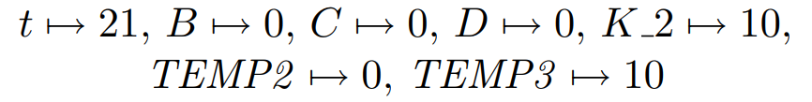
Model Checker ~ CFG

Slide 5
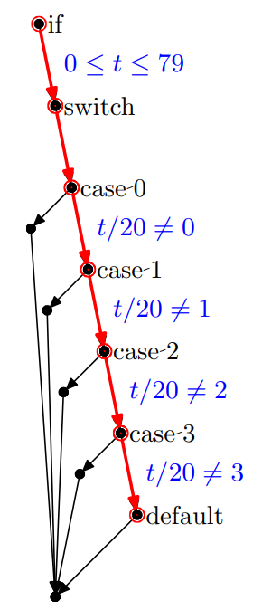
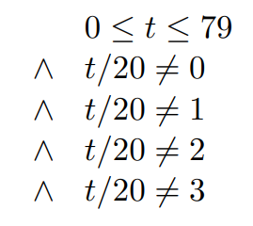
Model Checker ~ CFG
UNSATISFIABLE

Slide 6
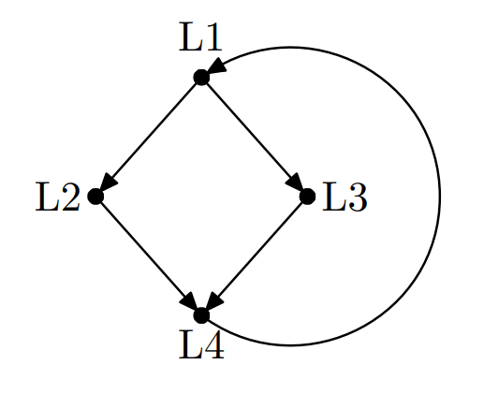
Bounded Model Checker
while(…){
if(…){
…
}
else{
…
}
}

Slide 7
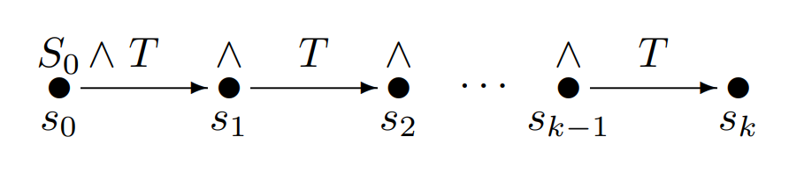
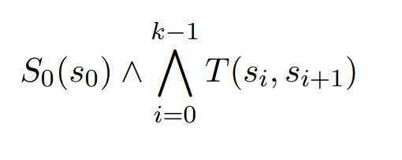
Bounded Model Checker
Formula:

Slide 8
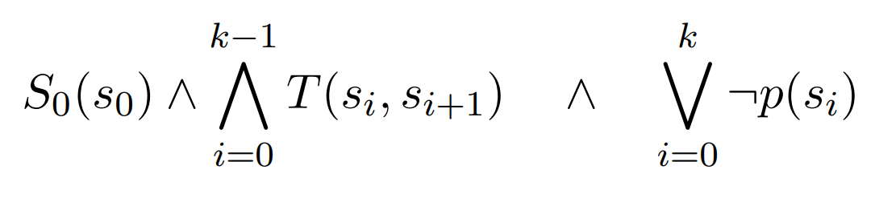
Bounded Model Checker
Formula:
Formula for property p:
(Optimization for only reachable code)
Notes:
Yields counterexample
Optimization: not for each state and each depth a formula

Slide 9
Bounded Model Checker
Eg.
while(condition){
body;
}
if (condition){
body;
while(condition){
body;
}
}
if (condition){
body;
if (condition){
body;
while(condition){
body;
}
}
}
Notes:
Yields counterexample
Optimization: not for each state and each depth a formula

Slide 10
Bounded Model Checker
if (condition){
body;
if (condition){
body;
if (condition){
body;
if(condition){
body;
if(condition){
body;
assert(!condition);
}}}}}
Proof that we have done enough unwindings

Slide 11
CBMC ~summary
C/C++ Source Code
Insert assertions
Parse tree
CFG
Formula
SAT solver
Counter-
example
Proof

Slide 12
Demo
Simple addition
uint8_t

Slide 13
Demo
Flight controller

Slide 14
Demo ~ Flight controller
IMU
Micro-controller
GPS
Radio
Motors

Slide 15
Thank you

Slide 16
References
  Clarke, E., Kroening, D., & Lerda, F. (2004, March). A tool for checking ANSI-C programs. In International Conference on Tools and Algorithms for the Construction and Analysis of Systems (pp. 168-176). Springer, Berlin, Heidelberg.
  http://www.cprover.org/cbmc/
  http://www.cprover.org/cbmc/doc/cbmc-slides.pdf

