Slide 1
Introduction to BIP
And a small outlook on how to apply it in the real world

Slide 2
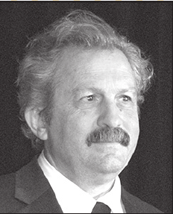
Overview
Rigorous System Design
BIP
An Example

Slide 3
Rigorous System Design ^{[5]}
As defined by Sifakis
A formal, accountable iterative process which satisfies:
Separation of concerns
Component Based
Semantically Coherent
Correct-by-Construction

Slide 4
Separation of Concerns
Goal: Separately addressing functional from extra-functional requirements
Achieved by Specifying a model which then gets s-to-s translated

Slide 5
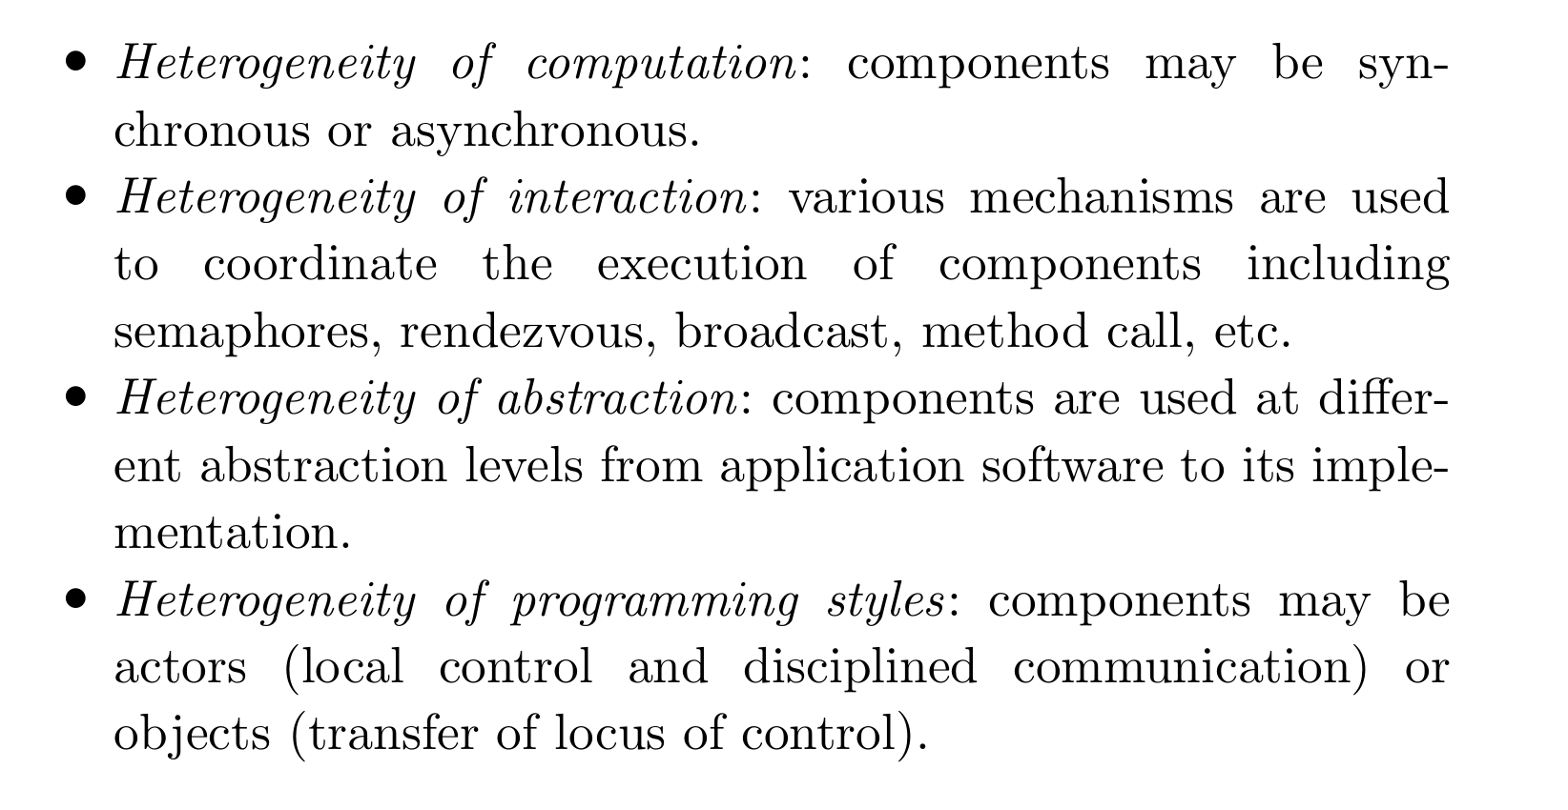
Component Based
Goal: Consistent Abstraction of Heterogenity of all kinds
Is achieved by building the system from atoms

Slide 6
Semantically Coherent
Goal: Ease of development and the chosen semantic should "easily embed" as many languages as possible*
Achieved by abstracting the hardware and software into the BIP language
*see [5] p. 333 for a definition of a homomorphism and a metric between languages

Slide 7
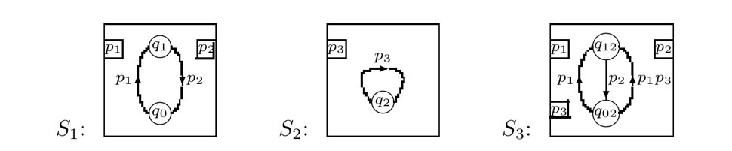
Correct-by-Construction
Goal: System of n-1 atoms can be extended by another atom without violating predicates holding for the n-1 atoms (horizontal correctness) and if the system is correct for a system-design step then it must be correct for all following design steps (vertical corr.)
Achieved by glue operators* (horizontal) and by substituting actions for their implementations (vertical)
Semi-Achieved Goal: Deadlock freedom (it always holds that any computation takes place)
* see [7] for an introduction to Glues

Slide 8
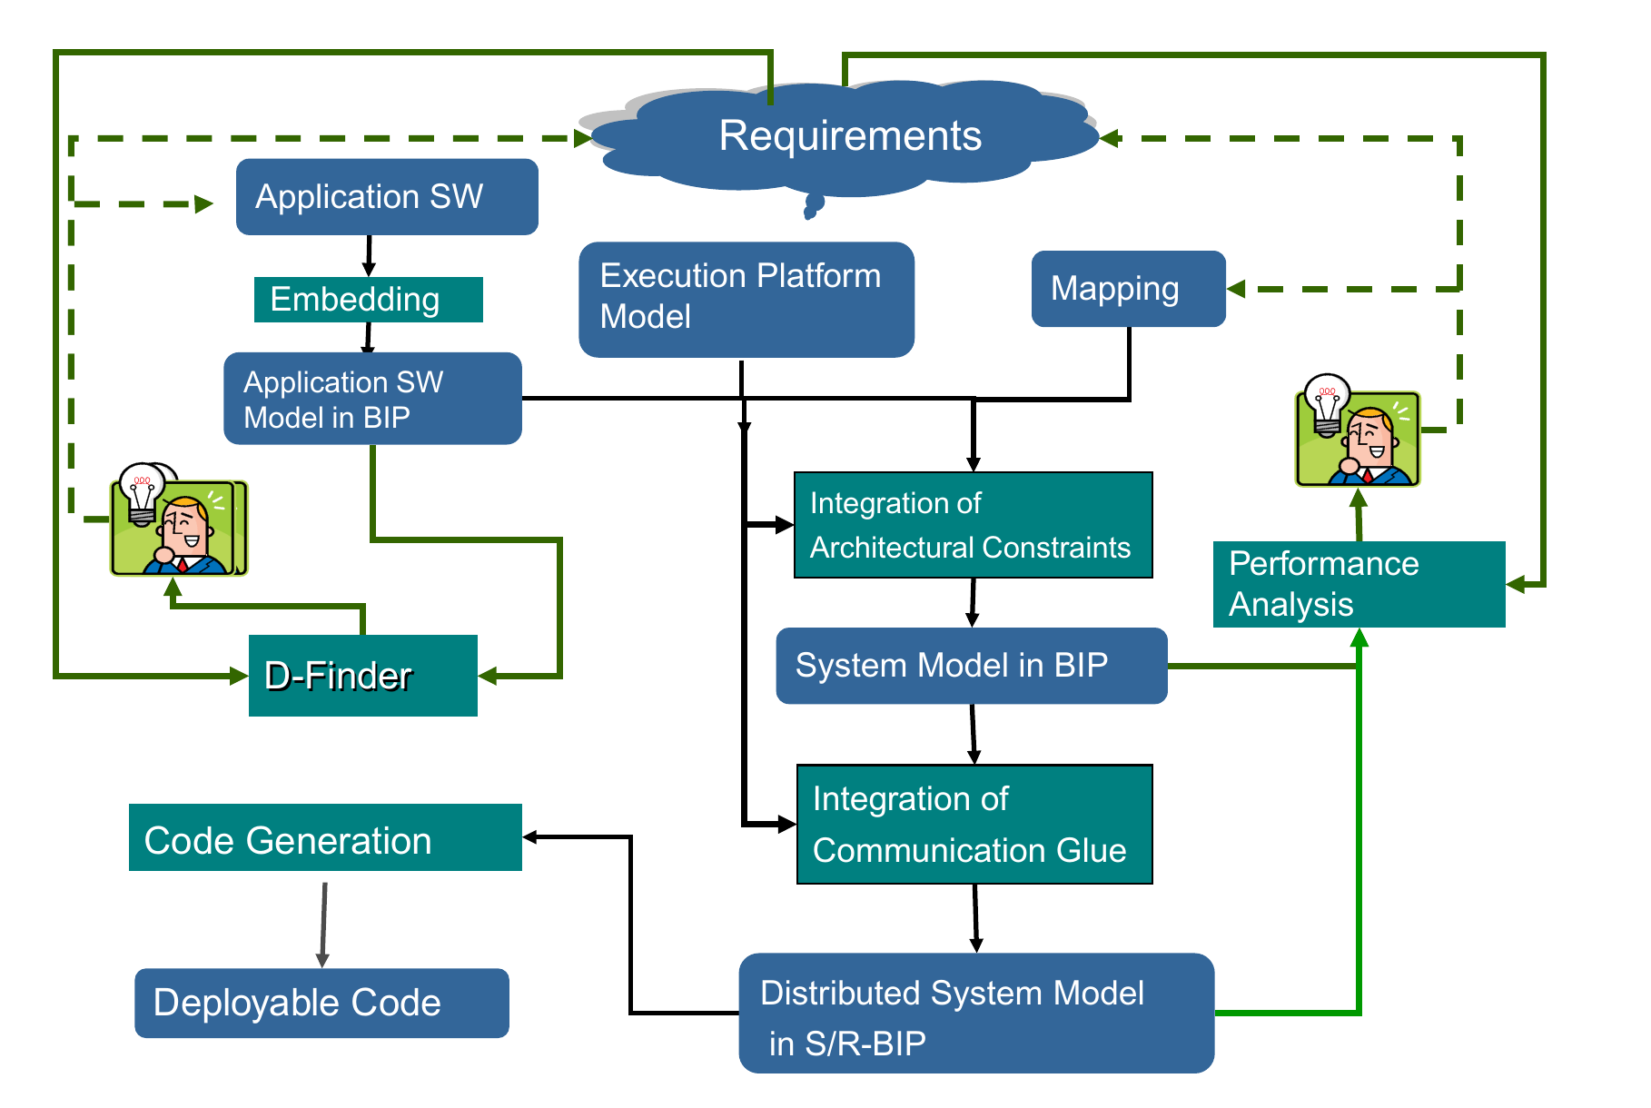
Design Flow ^{[5]}

Slide 9
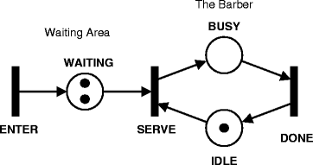
Behavior (Atoms)
Petri Nets (Used to be DFA in V1)
Access to global Time Tick
Can represent either hard- or software
Send & Receive Transitions via Ports for Connectors
Contains states
Image source:https://link.springer.com/referenceworkentry/10.1007/978-0-387-09766-4_134

Slide 10
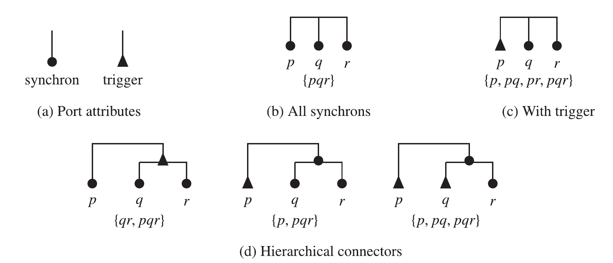
Interactions (Connectors between atoms)

Slide 11
Priorities
Choose which transition gets sent
Can avoid Deadlocks (inside a component) by preemption by prioritizing the process (atom) that waited longer
Can provide mutual exclusivity by providing the process which owns a resource highest priority

Slide 12
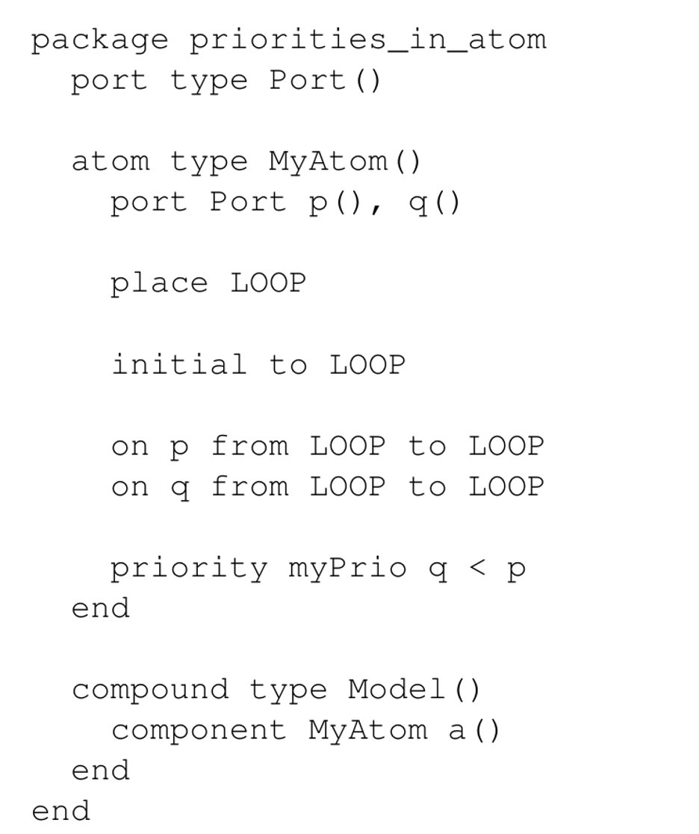
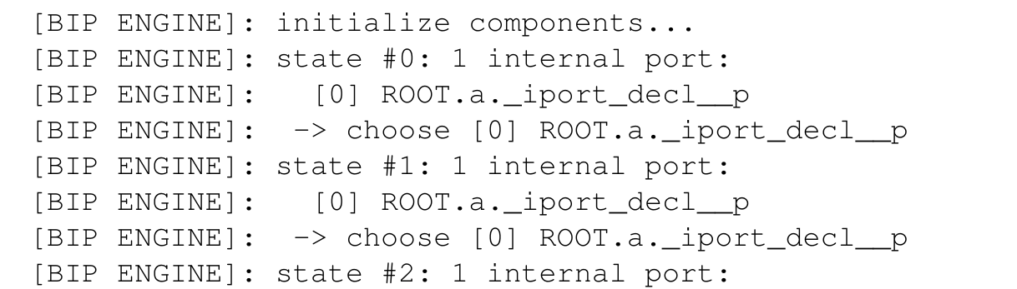
Priorities

Slide 13
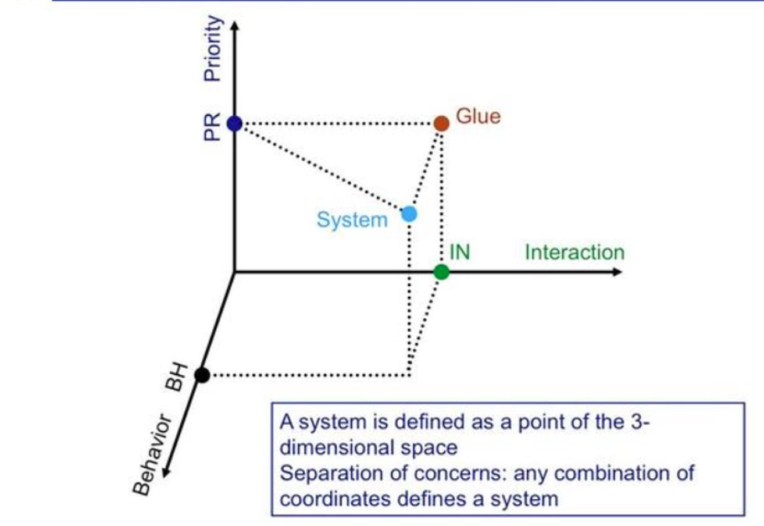
Separation of Concerns (again)
Image: [1]

Slide 14
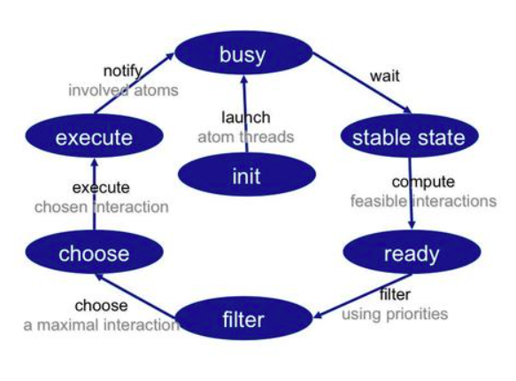
BIP Execution loop
Chooses which interaction happens
*real time BIP uses a different loop where parts of the involved work are analyzed and reduced at compile time

Slide 15
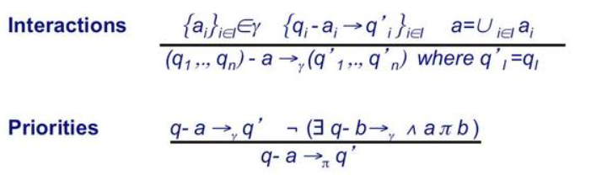
Glue-ing in BIP ^{[2] & [6]}
PR 3
PR 3 = P 1 ⊗ P2
I 3
P 1
P 2
I 3 = I 1 ⊕ I 2
I 1
I 2
A 1
P 1
P1.
A2
P2
P2.
A 1
P 1
P1.
A2
P2
P2.

Slide 16
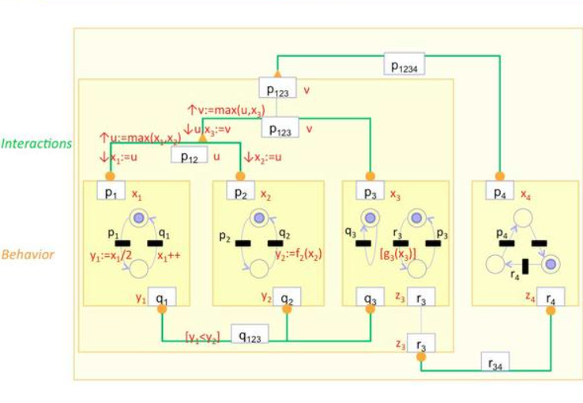
BIP Summary
Reusable, Verified, Composable Components
Larger systems can be verified thanks to correctness-by-construction
Semantically consistent Cyber-Physical System description
Image: [2]

Slide 17
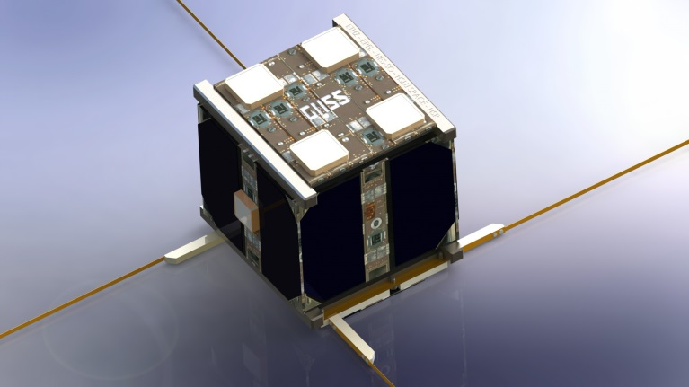
Cubesat (CubETH) Overview
Image: https://mpg.igp.ethz.ch/research/project-history/nano-satellites/cubeth.html
PL: Payload, HK: House keeping, CDMS: Commad Data Manganagmenet System, EPS: Electrical power subsystem

Slide 18
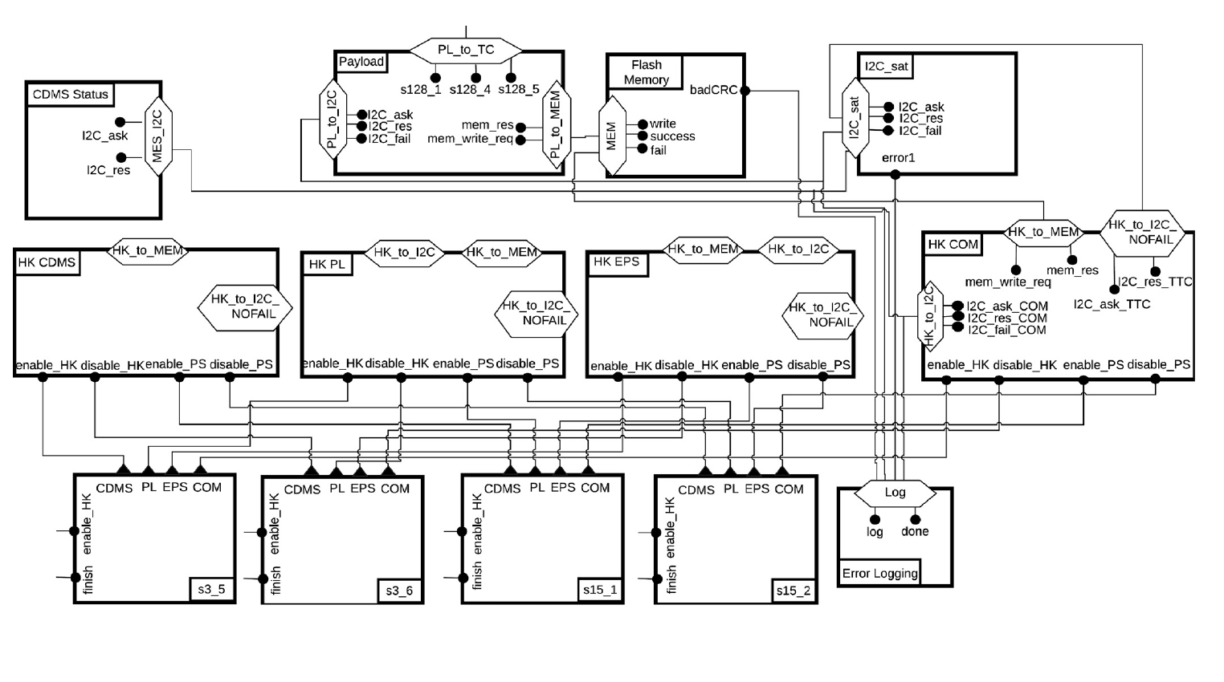
PL: Payload, HK: House keeping, CDMS: Command Data Managmenet System, EPS: Electrical power subsystem

Slide 19
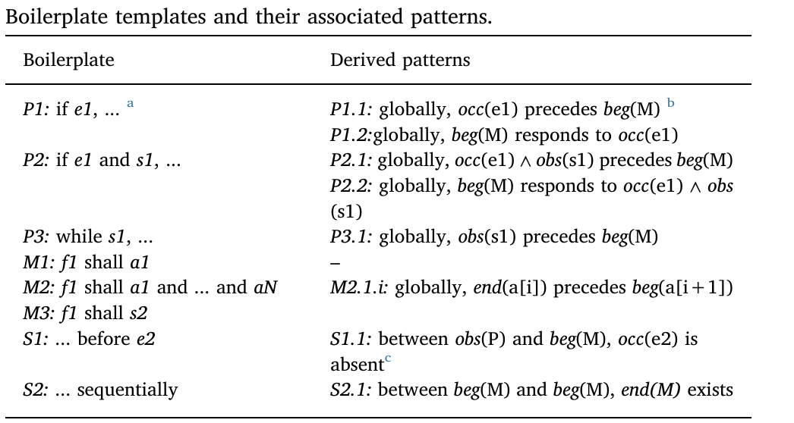
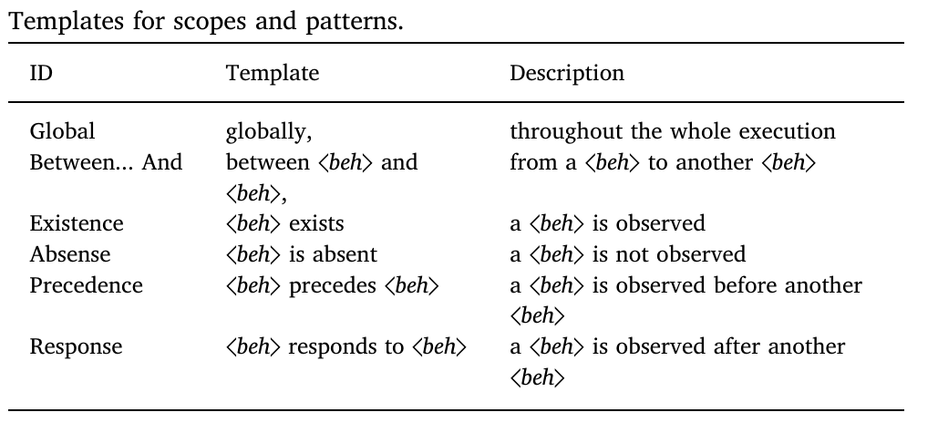
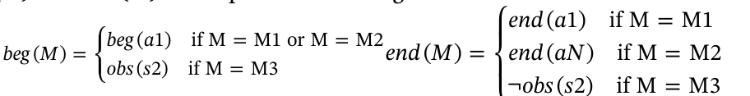
<beh> is a proposition (basically), a[i] is the ith action

Slide 20
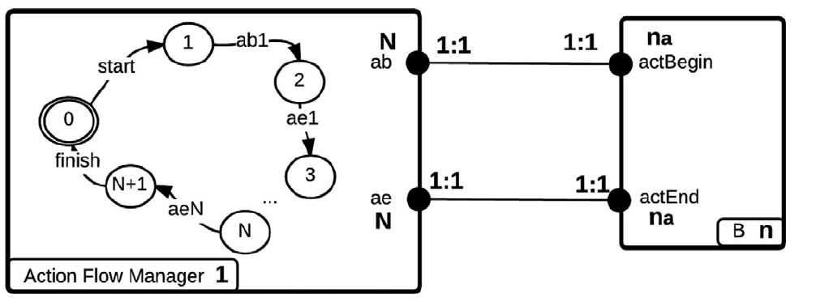
M2: f1 shall a1 and ... and aN

Slide 21
PL: Payload, HK: House keeping, CDMS: Command Data Managmenet System, EPS: Electrical power subsystem

Slide 22
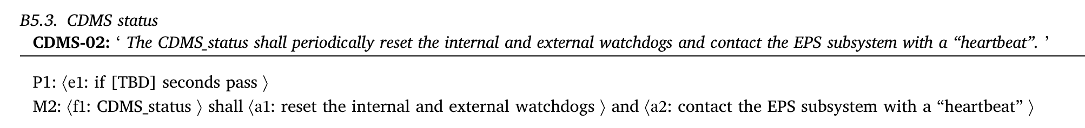
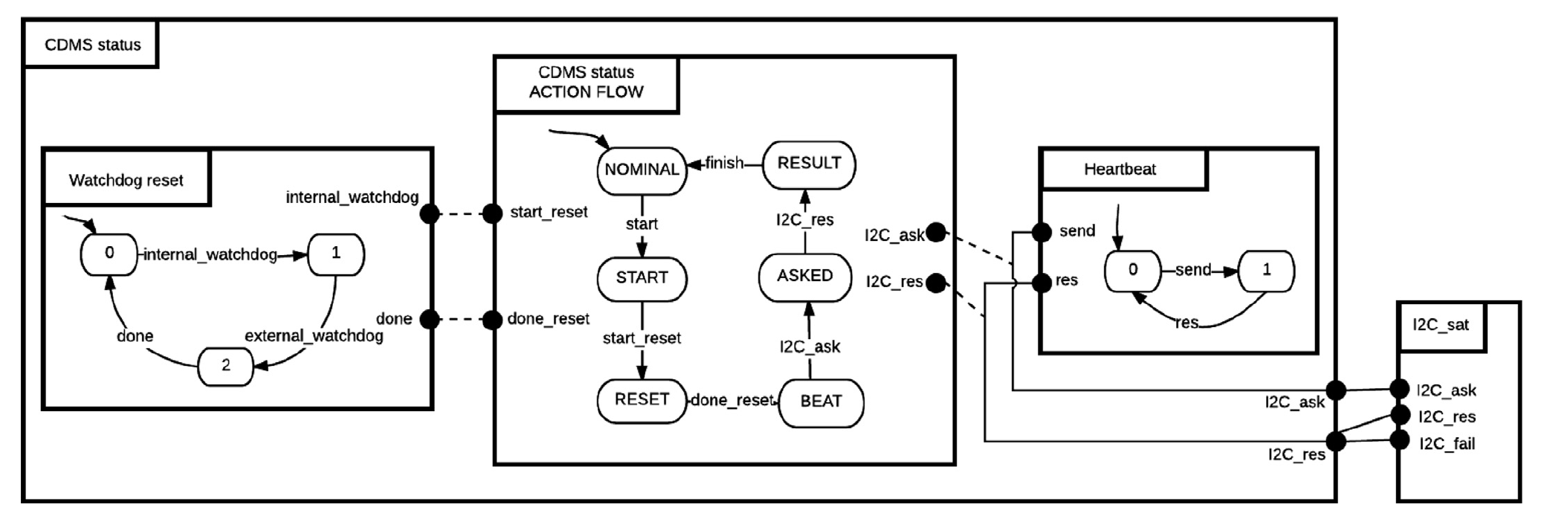

Slide 23
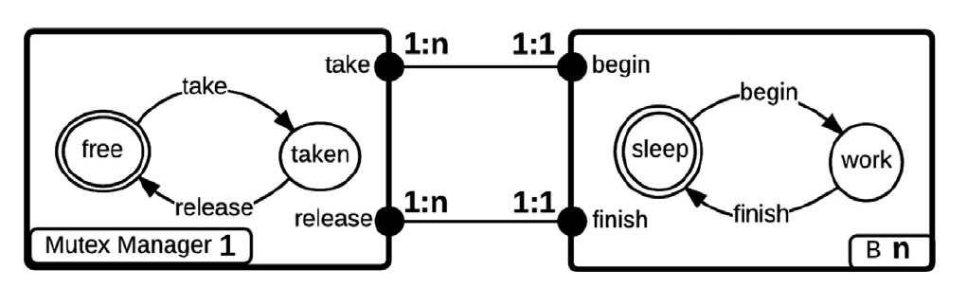
Patterns!

Slide 24
PL: Payload, HK: House keeping, CDMS: Command Data Managmenet System, EPS: Electrical power subsystem

Slide 25
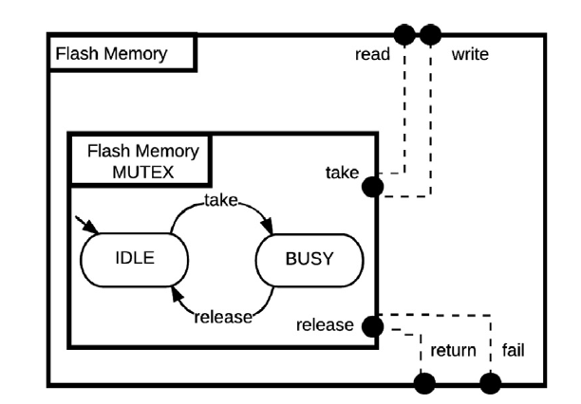

Slide 26
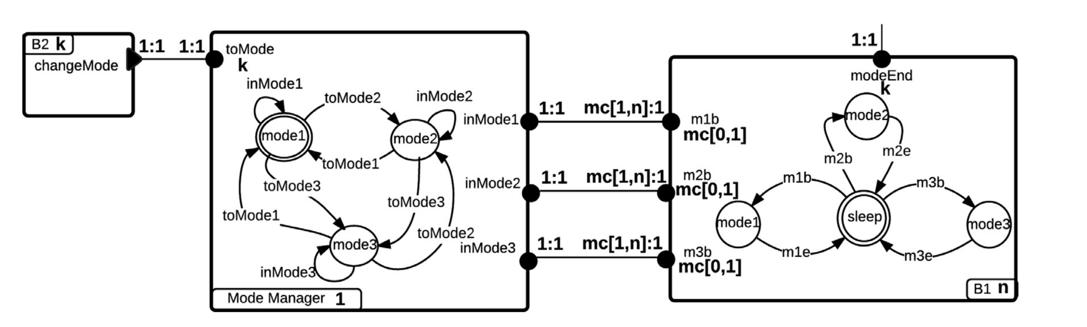
Mode Manager

Slide 27
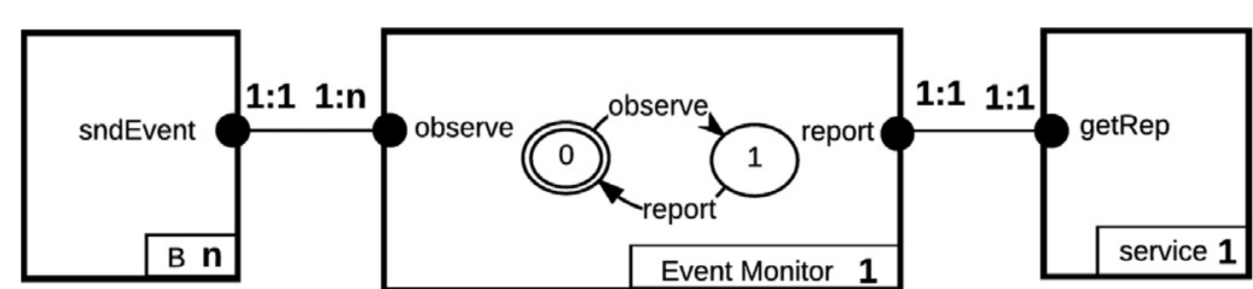
Event Monitor

Slide 28
CubETH Conclusion
38 requirements, from which 57 properties were derived
1 Action Flow, 11 Mode management, 5 Event monitoring, 10 Mutual Exclusion Management and 3 Failure Monitoring
RERD was used to automate part of the model creation process
System is deadlock free (D-Finder was used)

Slide 29
Sources
Questions?
[1] https://slideshot.epfl.ch/play/sifakis1
[2] https://slideshot.epfl.ch/play/sifakis2
[3] https://www-verimag.imag.fr/The-BIP-Design-Flow.html?lang=en
[4] http://science.mq.edu.au/~fcassez/bib/papers/wcet-2012.pdf
[5] https://www-verimag.imag.fr/~sifakis/papers_pdfs/Rigorous%20System%20Design.pdf
[6] https://link.springer.com/chapter/10.1007/978-3-540-85361-9_39
[7] https://www-verimag.imag.fr/PEOPLE/Joseph.Sifakis/RecentPublications/2011/constraints-bliudze-sifakis-sc2011.pdf
[8] https://hal.archives-ouvertes.fr/hal-01873999/document

Slide 30
