Slide 1
Distributed Systems and TLA+ (T2)
Andy Keller

Slide 2
Outline
Introduction
What is TLA+?
Why should you care?
Industry example
Caveats
Crash course TLA+
Practical demo
Conclusion and resources
Questions

Slide 3
Introduction: Distributed Systems are Difficult
“A distributed system is one in which the failure of a computer you didn't even know existed can render your own computer unusable.” – Leslie Lamport
“Everything about distributed systems is terrible.” – Hillel Wayne
Lost messages, race conditions, deadlock, etc.
Example: Money transfer
Amount of reachable states increases much faster
Not viable to manually test every scenario

Slide 4
Introduction: Temporal Logic and Testing
“Program testing can be used to show the presence of bugs, but never to show their absence.” – Edsger W. Dijkstra
But what if we could consider every possible scenario?
I.e. Make the computer do it
Formal methods: use math to eliminate bugs*
*in the design only, you still need to test implementation.

Slide 5
What is TLA+?
Temporal Logic of Action, a formal specification language by Leslie Lamport
Tool for specifying and verifying a program or system
Catch design bugs before implementation
Verification by going through every possible state (TLC model checker)
Mathematical description – closer to the essence of an algorithm
Basically just propositional logic and sets
Properties rather than instructions
“Thinking better”, flexible level of detail/abstraction

Slide 6
Why should you care?
“Weeks of debugging can save you hours of TLA+” – Markus Kuppe
Catch bugs that might’ve crashed your system months after going productive
More time- and cost-effective than debugging and rewriting
Simpler systems are easier to implement and maintain
Developers cost money
→ Save money

Slide 7
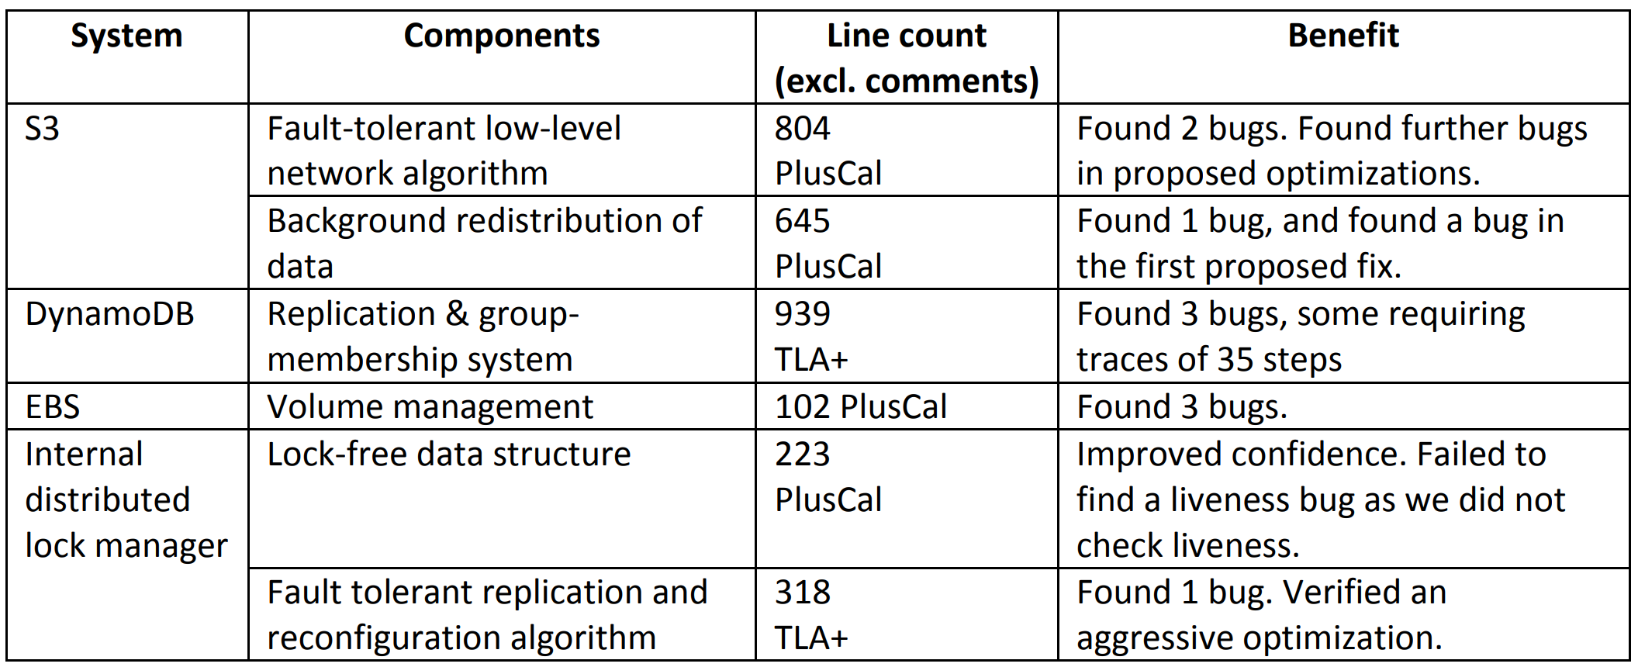
Industry Example: AWS “Debugging Designs”
“What might go wrong?” vs. “What needs to go right?”
Safer changes: prevent subtle, critical bugs from reaching production
Formal specification as very precise documentation

Slide 8
Caveats
Logical livelocks vs time-out due to e.g. a momentary slowdown
Not so beneficial for smaller, less critical projects
The model may not be an accurate representation of what is needed
The code may not actually reflect the model

Slide 9
Crash course: How it works
State: assignment of values to variables
Behavior: sequence of states (i.e. execution traces)
Module defining the allowed/possible behaviors as mathematic formulas (through Init and Next)
Model to test the module
Honorable mention: PlusCal (transpiles to TLA+)

Slide 10
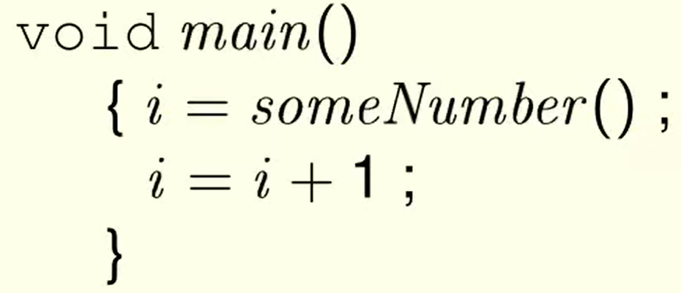
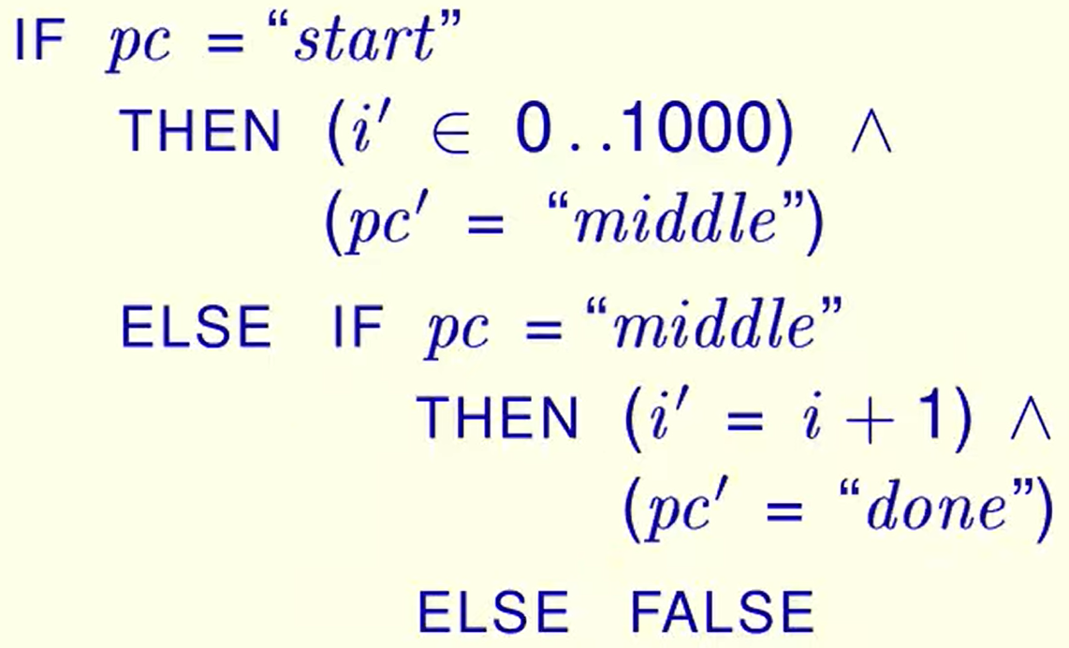
Crash course: From PL to Math to TLA+

Slide 11
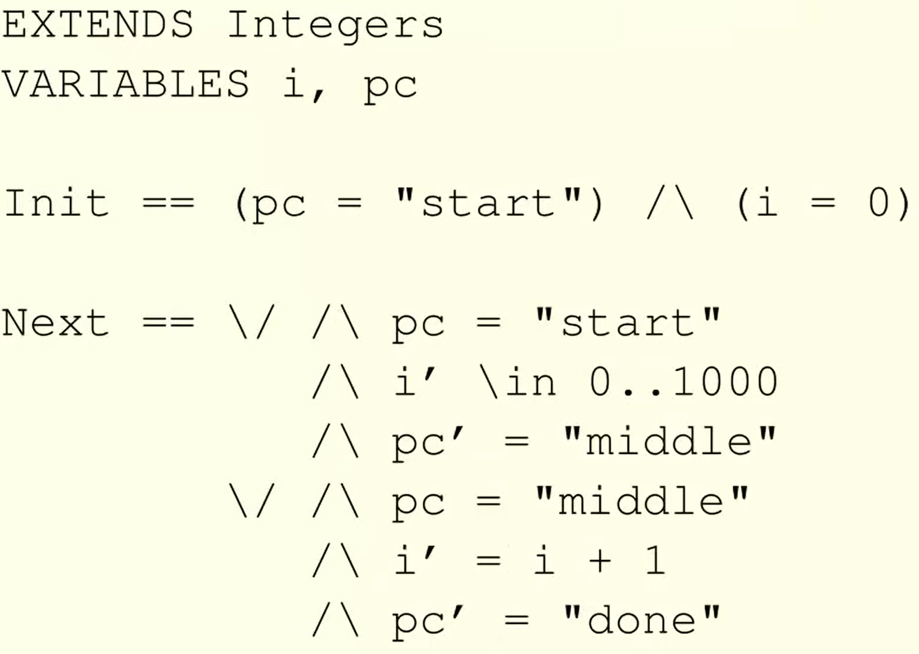
Crash course: simple module and pretty print

Slide 12
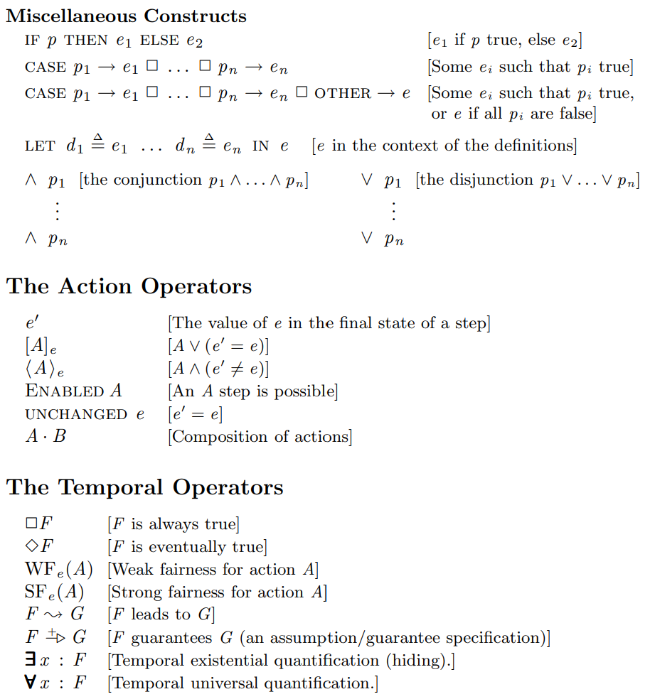
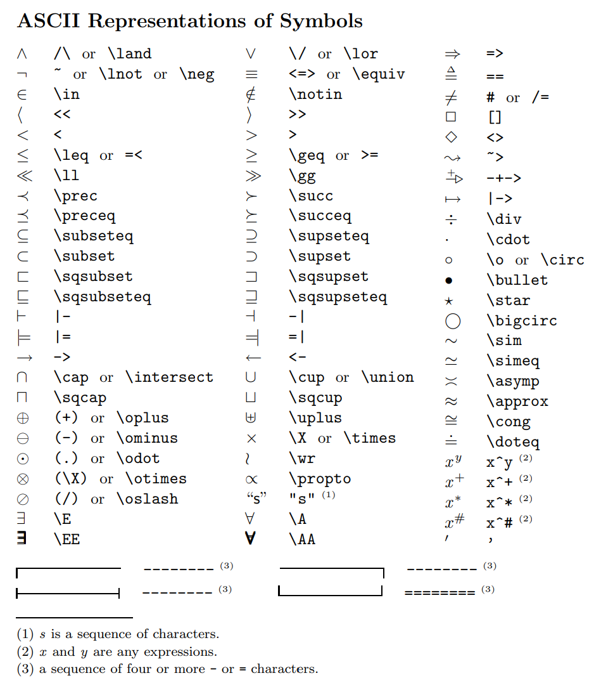
Crash course: TLA+ Syntax

Slide 13
Practical demo

Slide 14
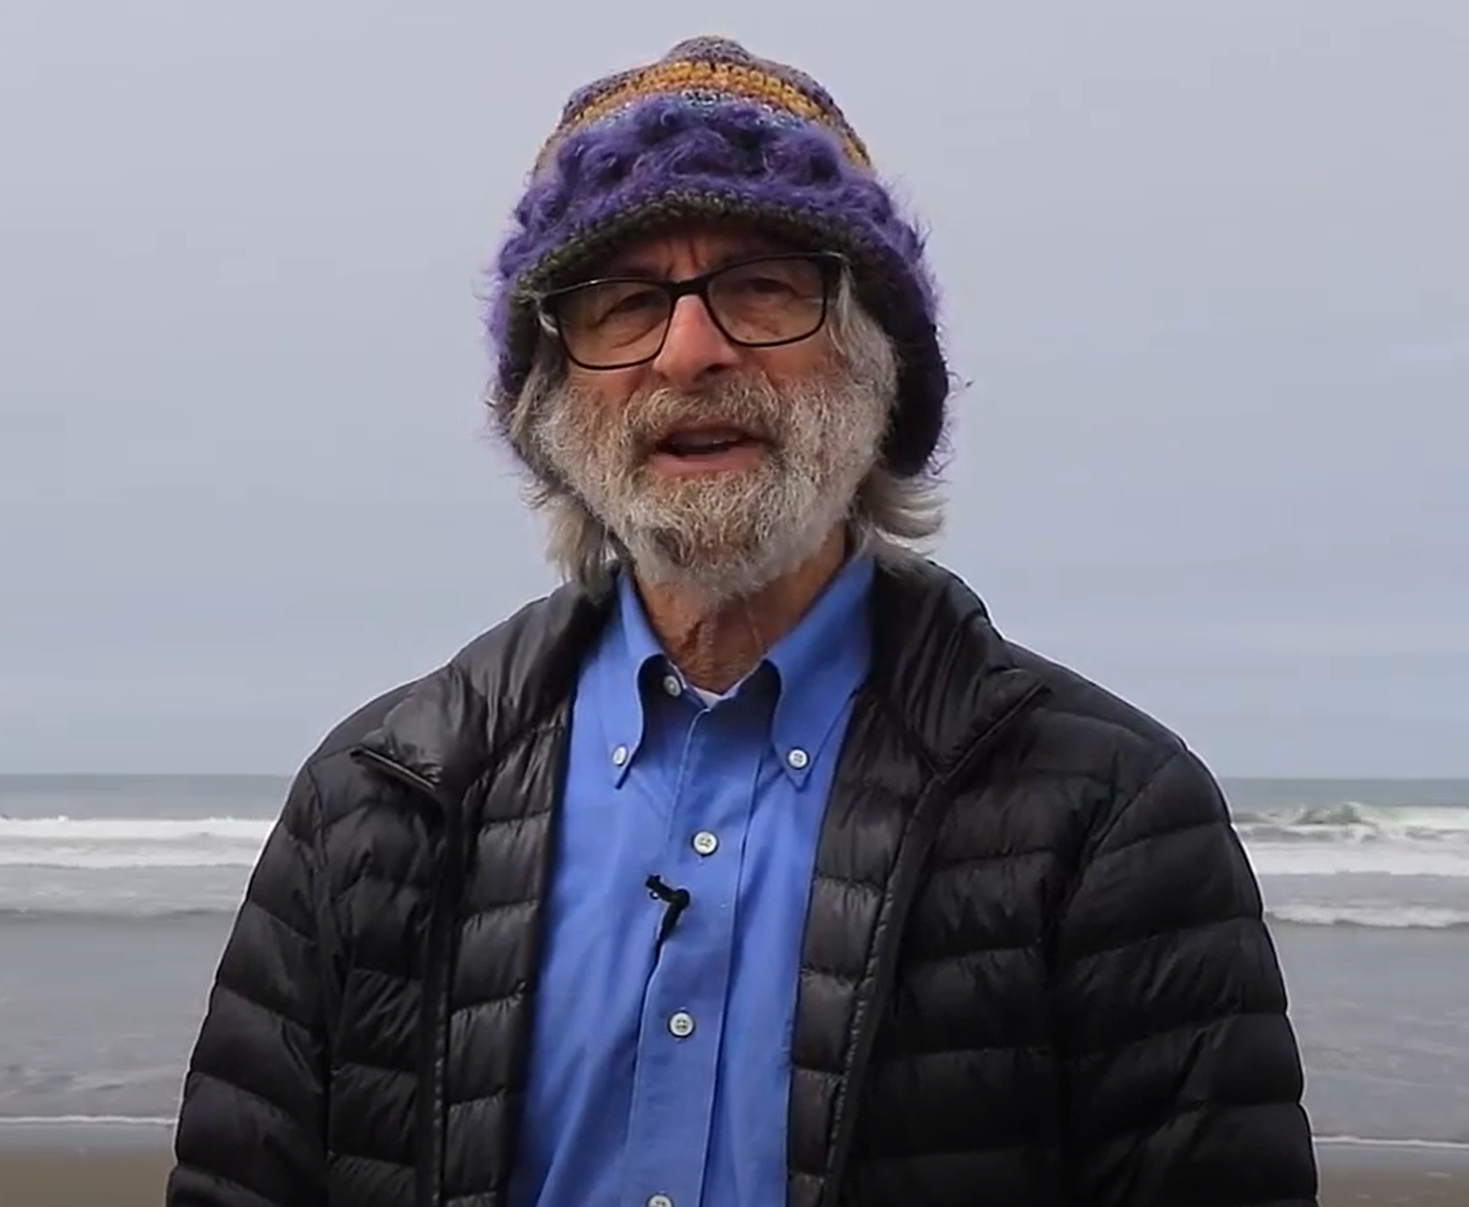
Conclusions and resources
Leslie Lamport’s video series and hyperbook
Hillel Wayne’s site and live talks
Ron Pressler’s blogs on TLA+
Use of Formal Methods at Amazon Web Services

Slide 15
Questions?

